Slide 1
Syntax Pal
Your code’s AI co-pilot

Slide 2
AI- Driven Code Optimizer
Syntax Pal

Slide 3
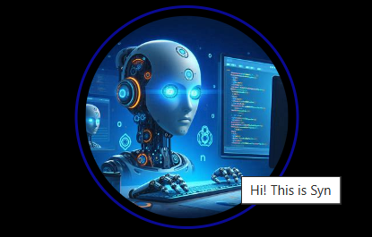
What is Syn?
Syn is your personal chatbot that helps you with programming.
It can automatically review code, identify potential bugs, suggest improvements, and optimize performance.
It supports multiple programming languages and can integrate with popular code editors.
It is specially designed to assist you with any programming-related query!
Hence, it does not answer your queries from other topics.

Slide 4





Customized icon
Quick login
Accurate search and result
Specialized
Programming chatbot
Easy logout

Slide 5
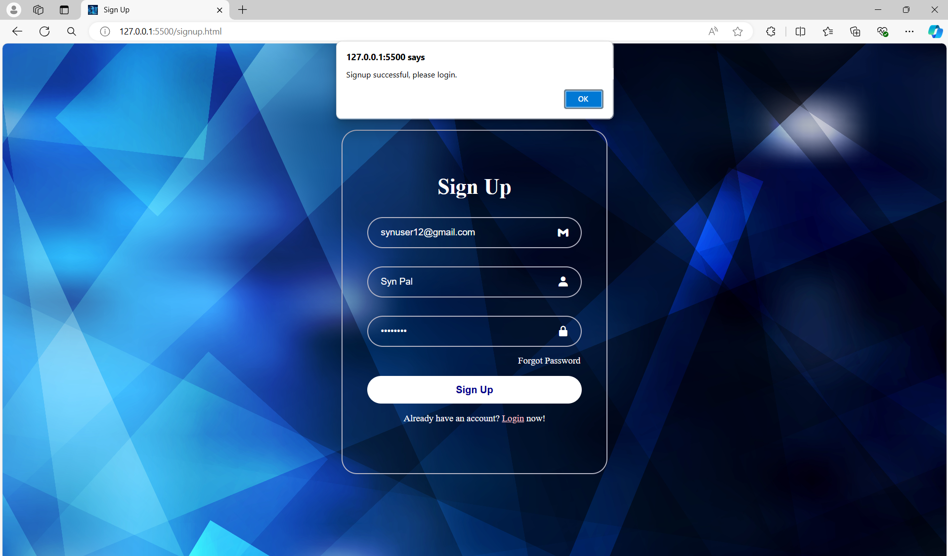
Easy Login/ Signup
You can sign up / login with your Gmail and password.
A username you prefer will be asked to add to your profile.
Once you create your account, then you can login and you’ll be directed to the chat with Syn.

Slide 6
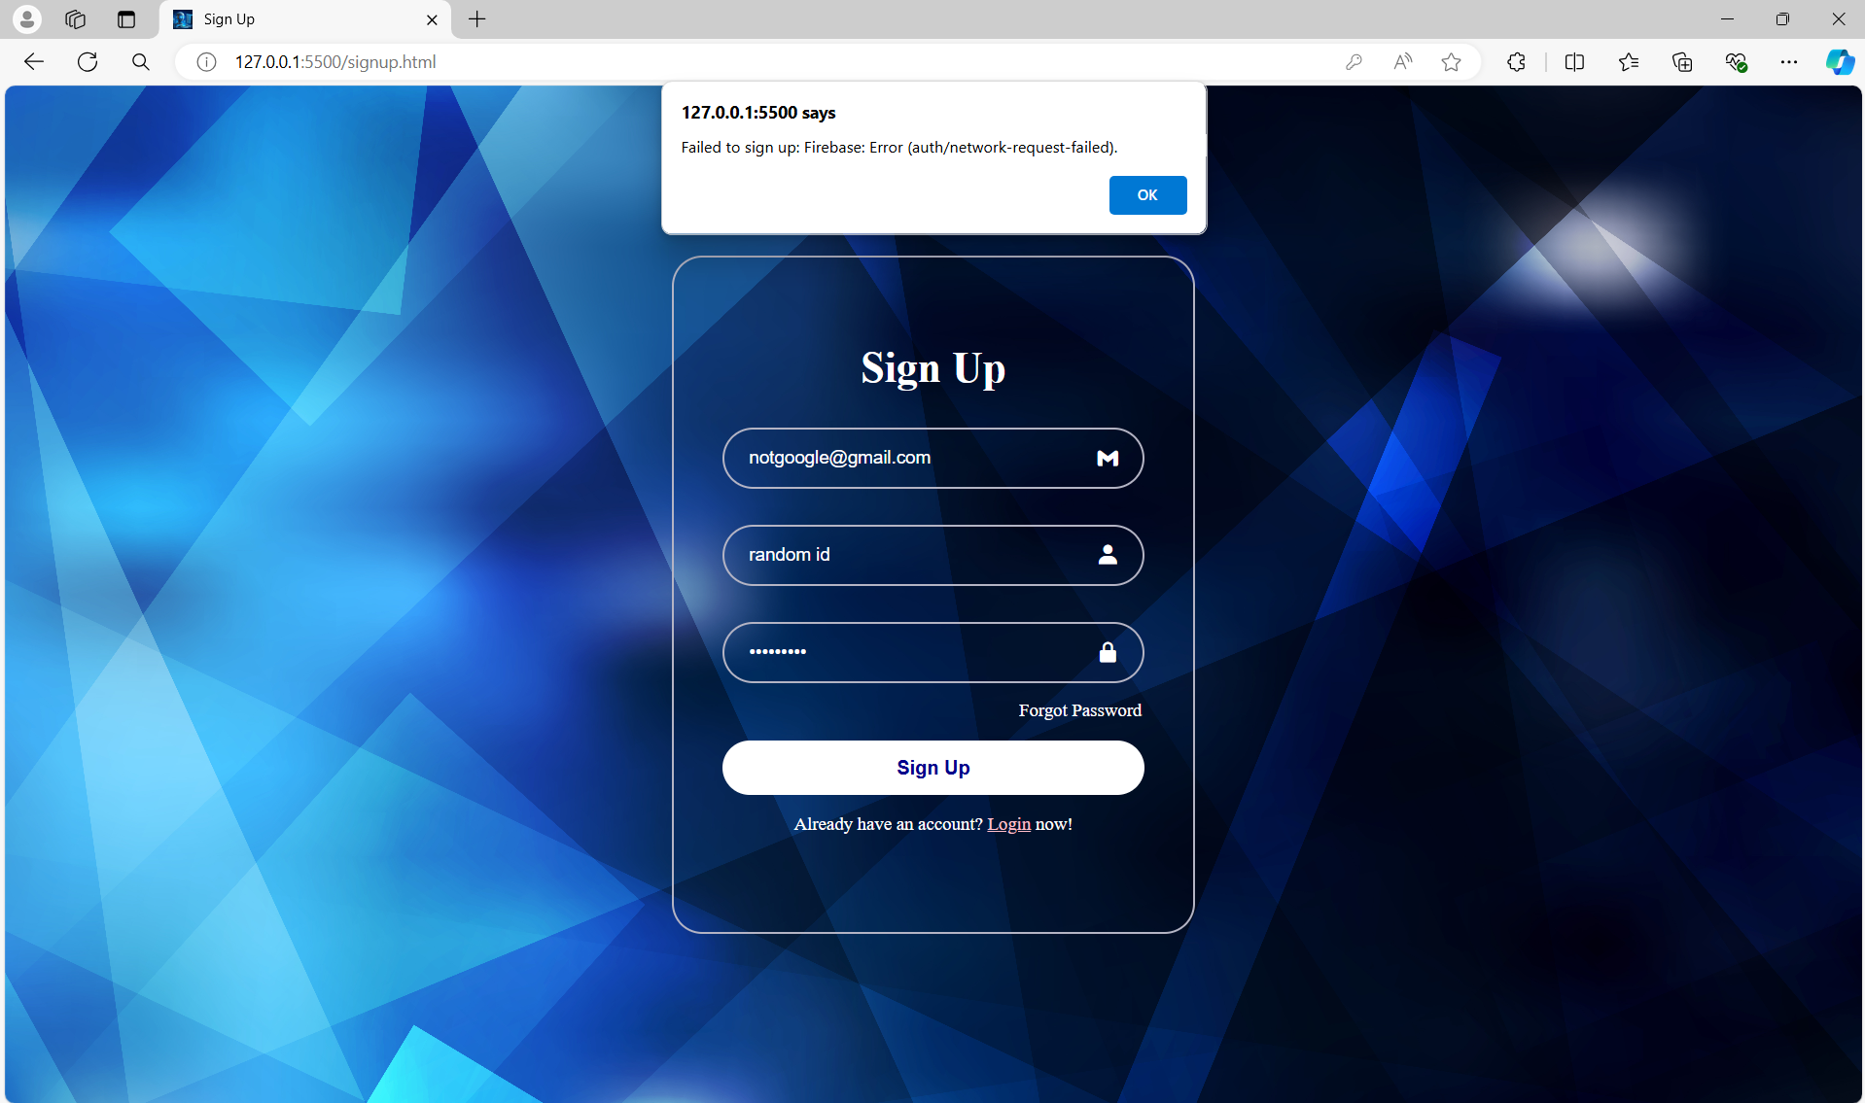
Non-database Mail-ID
SyntaxPal accepts only Mail-IDs that are already present in the Google mails database.
So, if your mail id is not in the mentioned database, you cannot signup or login.

Slide 7

Unregistered account
You should first sign-up to create an account (register) to access the bot.
You cannot login without signing-up initially.

Slide 8
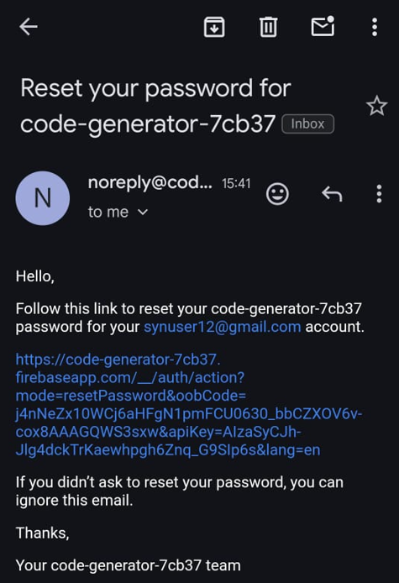
Forgot Password?
Did you forget your password to login?
Don’t worry. Click on “Forgot password” and you will get a mail to your registered email so that you can reset your password.

Slide 9


Chatbot
Once you login successfully, the bot-page is viewed.
To initialize the conversation, click on the hovering “chat 💭” present in the bottom-right of the page.
And you start your chat then!

Slide 10
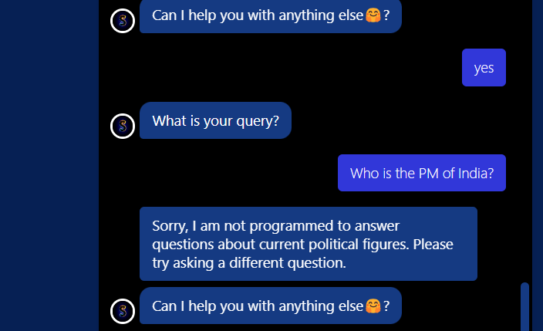
Chatbot
As said earlier, this chatbot is designed specially to assist you only with programming-related queries.
Hence if you ask something that is not programming-related, it can not answer.
This feature makes it a perfect and exclusively-coding assistant bot.

Slide 11

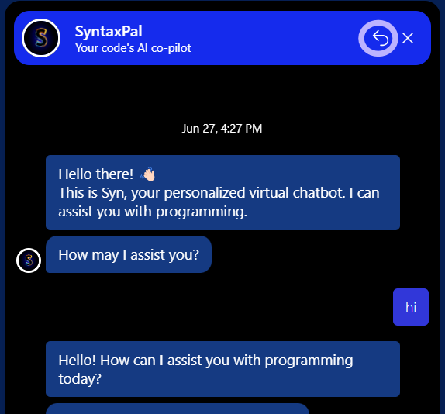
Delete Chat
Syn has a special feature to delete your previous chats.

Slide 12
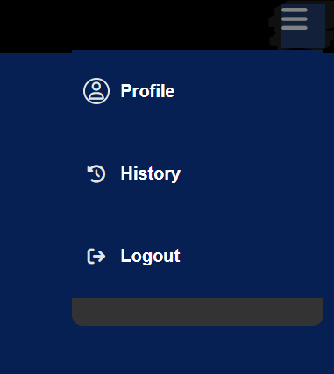
Toggle-Menu
Click on the toggle-menu to view options.
You are advised to logout after your session for privacy reasons!

Slide 13
Refine, Optimize, Elevate

Slide 14
Coming Soon..
Profile
Avatars for profile picture
History
Share chat
Download chat

Slide 15
Akella Akhila Karri Jothirmai Kommireddi Jayanthi

Slide 16
Thank You

